Slide 1
Self-Check Laboratory Exercise III (Full Add/Sub Unit)
Anthony Ramos
CSC342/342
Spring 2021

Slide 2
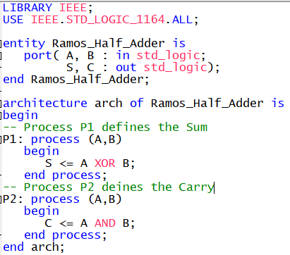
Task 1 - Half Adder
Make use of two processes!
Figure 1: Half Adder Component (Using Processes)

Slide 3
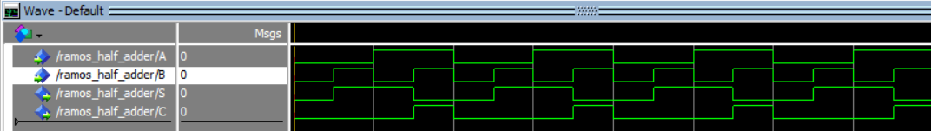
Task 1 - Half Adder
In a Half-Adder, the Sum (S) is defined by applying the Boolean Operation A XOR B. Likewise, the Carry (C) is defined by apply the Boolean Operation A AND B.
Figure 2: Half Adder Component (Using Processes) Simulation

Slide 4
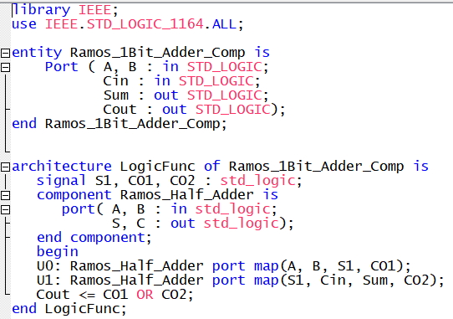
Task 2: 1-Bit Full Adder
We’re using our Half-Adder
from task 1
Figure 3: 1-Bit FA using Half Adder as component

Slide 5
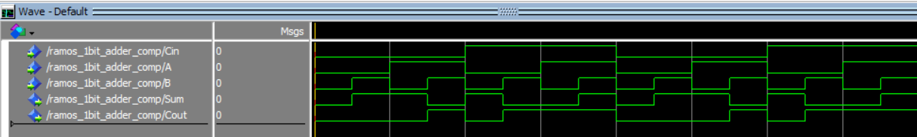
Task 2: 1-Bit Full Adder
0 0 0 0 1 1 1 1 0 0 0 0 1 1 1 1
0 0 1 1 0 0 1 1 0 0 1 1 0 1 1 1
0 1 0 1 0 1 0 1 0 1 0 1 0 1 0 1
0 1 1 0 1 0 0 1 0 1 1 0 1 0 0 1
0 0 0 1 0 1 1 1 0 0 0 1 0 1 1 1
Figure 4: 1-Bit FA using Half Adder as component (Simulation)

Slide 6
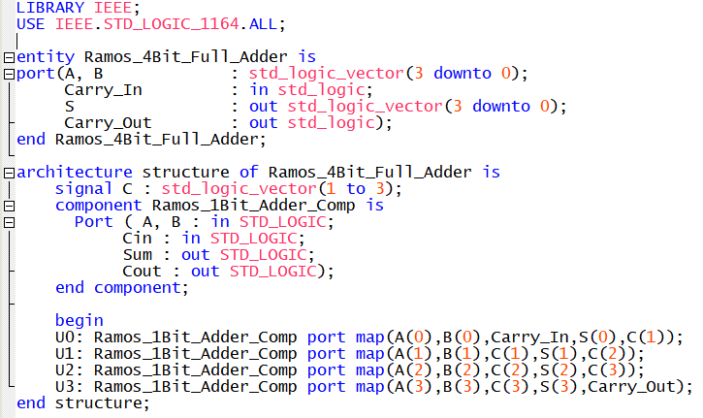
Task 3: 4-Bit Full Adder
We’re using our Full-Adder
from task 2
Figure 5: 4-Bit FA using 1-Bit FA as component

Slide 7
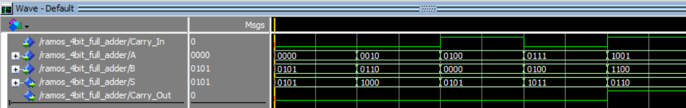
Task 3: 4-Bit Full Adder
With different values for A, B, and carry-in (Cin), the adder computes A+B along with any carry-out (Cout). The waveform above indeed shows correct summations (e.g. 0111 + 0100 = 1011 -> 7 + 4 = 11).
Figure 6: 4-Bit FA using 1-Bit FA as component (Simulation)

Slide 8
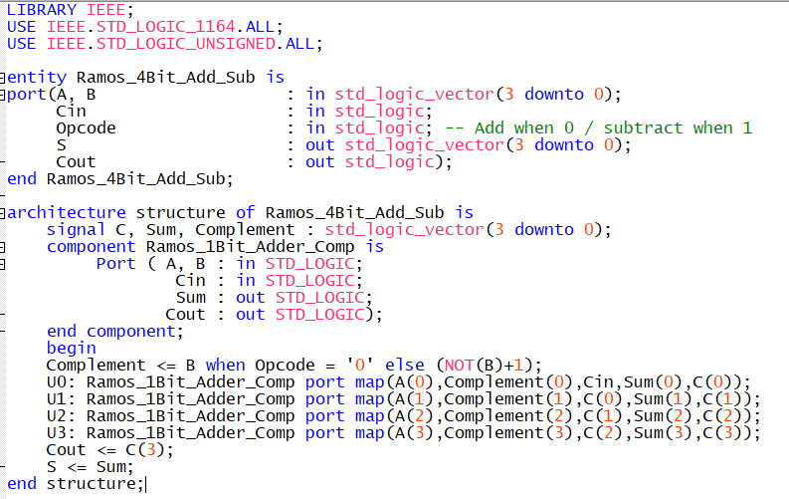
Task 4: 4-Bit Full Adder/Subtractor
Figure 7: 4-Bit Full Adder/Subtractor

Slide 9
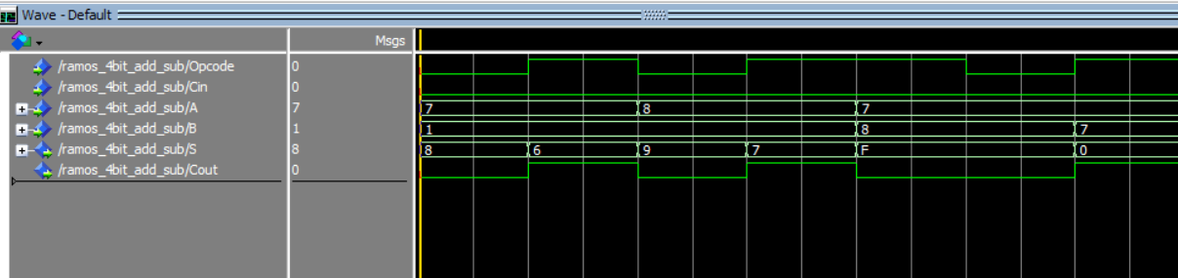
Task 4: 4-Bit Full Adder/Subtractor
a b c d e f g
7 + 1 = 8 7 – 1 = 6 -8 + 1 = -7 -8 – 1 = -9 7 – (-8) = 15 7 + (-8) = -1 7 - 7 = 0
A and B have been chosen with specific values to meet the testing specifications of task 8. The Opcode determines whether addition or subtraction is performed when it is set to 0 or 1 respectively. In some cases, the Sum (S) isn’t what we’d expect. Thus far, we have not implemented a mechanism to check if the sum is negative or if an overflow has occurred.
Figure 8: 4-Bit Full Adder/Subtractor (Simulation)

Slide 10
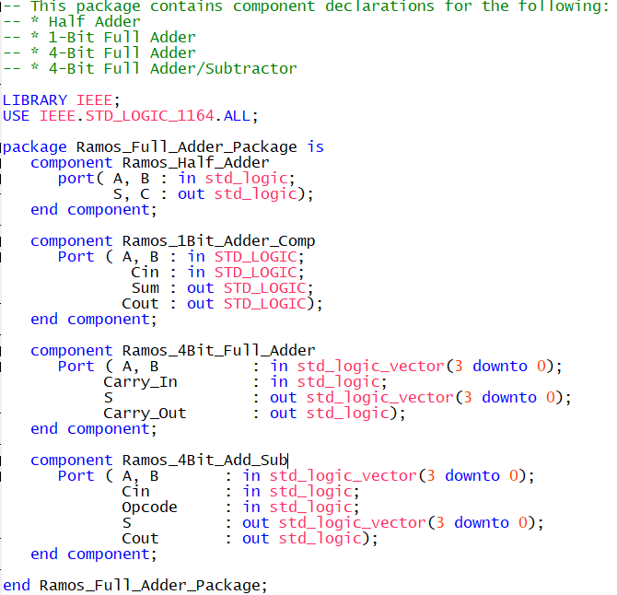
Task 5: Declaring a Package
Required statement for package declaration
Figure 9: Package Declaration

Slide 11
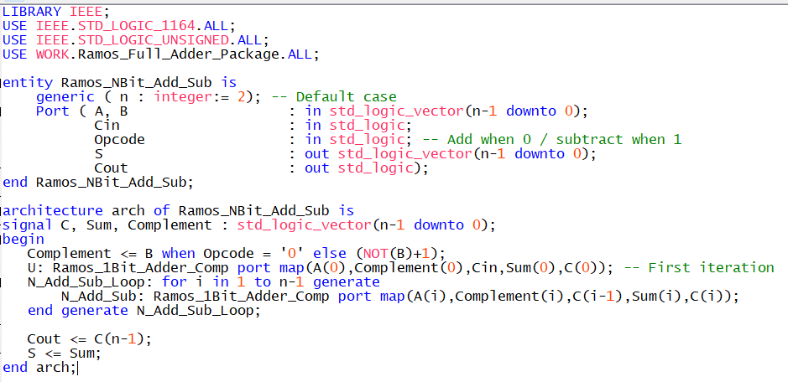
Task 6: N-Bit Full Adder/Subtractor
Required use of generic keyword with default case
Figure 10: N-Bit Full Adder/Subtractor

Slide 12
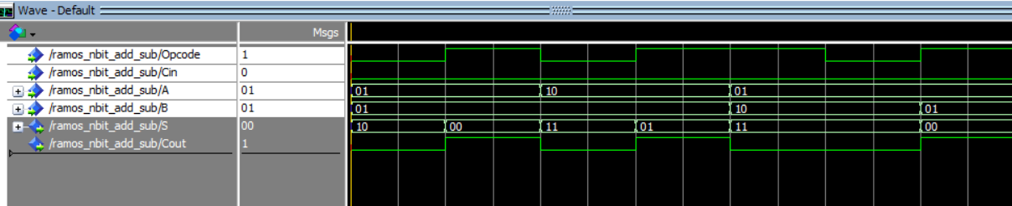
Task 6: N-Bit Full Adder/Subtractor
a b c d e f g
1 + 1 = 2 1 – 1 = 0 -2 + 1 = -1 -2 – 1 = -3 1 – (-2) = 3 1 + (-2) = -1 1 - 1 = 0
In an N-bit adder, A and B are of length N. For simplicity, the default value was set to N = 2. To test this now 2-Bit Adder/Subtractor, A and B have been chosen with specific values to meet the testing specifications of task 8. The Opcode determines whether addition or subtraction is performed when it is set to 0 or 1 respectively. Again, some values of Sum (S) aren’t what we’d expect. We still have not implemented a mechanism to check if the sum is negative or if an overflow has occurred.
Figure 11: N-Bit Full Adder/Subtractor (Simulation)

Slide 13
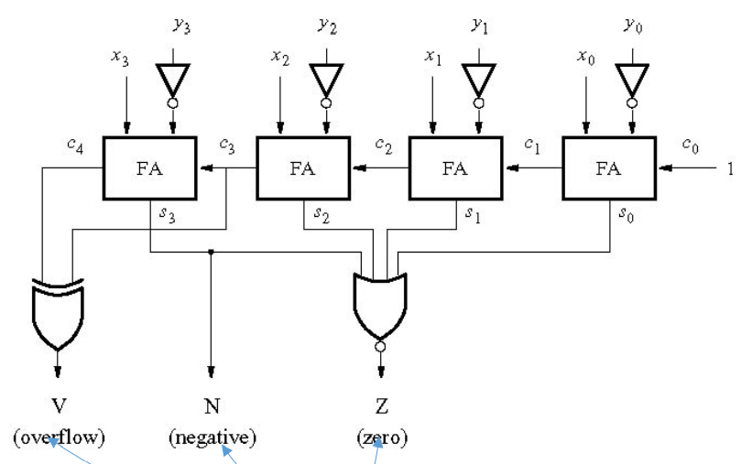
Implementing V,Z,N Flags
Overflow (V) Flag: Set to 1 if the carry-in and carry-out of bit n differ via XOR operation
Zero (Z) Flag: The result of applying the NOR operation to all n bits in Sum
Negative (N) Flag: Set to 1 of the most significant bit is 1
Figure 12: Implementing V,Z,N Flags

Slide 14

Implementing V,Z,N Flags (4-Bit Case)
However, not a good way to define the Z_FLAG for N-bits!
Figure 13: Boolean Expressions for V,Z,N flags (4-Bit Case)

Slide 15
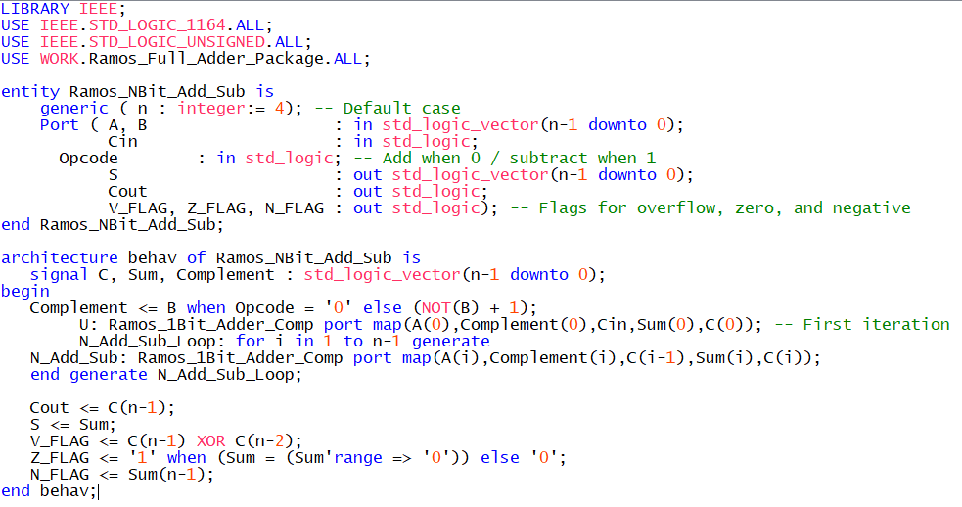
Task 7: N-Bit FA/S (With V,Z,N Flags)
Required use of generic keyword with default case
Make use of ‘range’ keyword to check if Sum > 0
Generic V,Z,N flag indicators
Figure 14: N-Bit Adder/Subtractor with V,Z,N flags

Slide 16
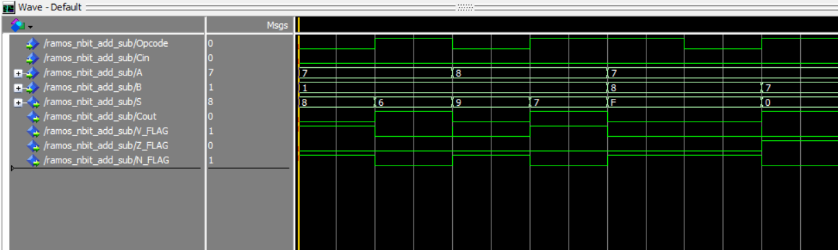
Task 8: Verification (N = 4)
Should be 1
a b c d e f g
7 + 1 = 8 7 – 1 = 6 -8 + 1 = -7 -8 – 1 = -9 7 – (-8) = 15 7 + (-8) = -1 7 - 7 = 0
overflow overflow overflow
Figure 15: N-Bit Adder/Subtractor with V,Z,N flags (Simulation) (N = 4)

Slide 17
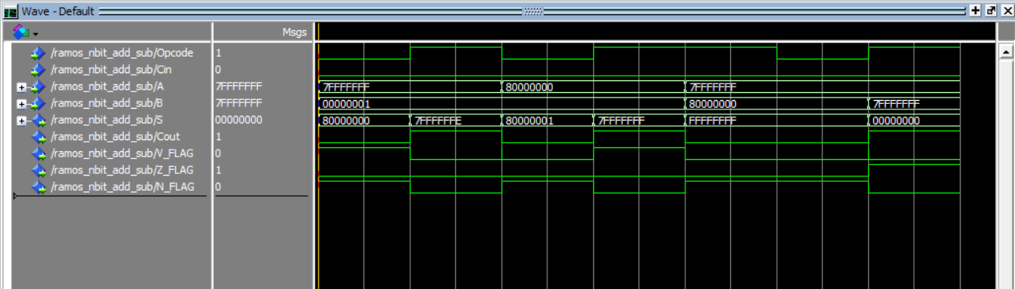
Task 8: Verification (N = 32)
Should be 1
a b c d e f g
overflow overflow overflow
Figure 16: N-Bit Adder/Subtractor with V,Z,N flags (Simulation) (N = 32)

Slide 18
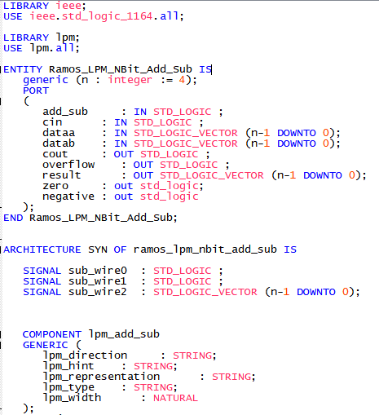
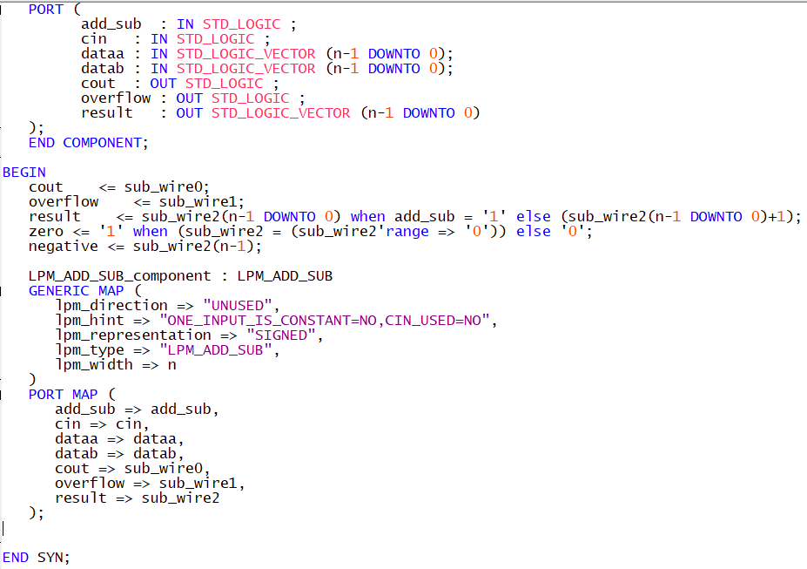
Task 9 - N-Bit Adder/Subtractor (LPM)
Figure 17: N-Bit Adder/Subtractor with V,Z,N flags (LPM)

Slide 19
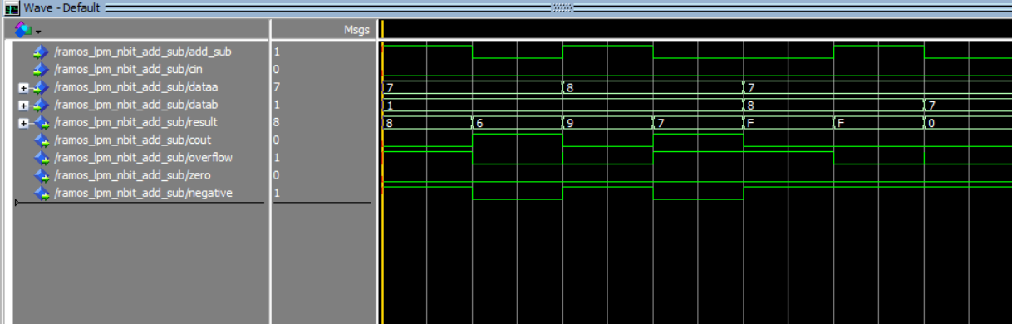
Task 9 - N-Bit Adder/Subtractor (LPM)
a b c d e f g
7 + 1 = 8 7 – 1 = 6 -8 + 1 = -7 -8 – 1 = -9 7 – (-8) = 15 7 + (-8) = -1 7 - 7 = 0
overflow overflow overflow
Figure 18: N-Bit Adder/Subtractor with V,Z,N flags (LPM Simulation) (N = 4)

Slide 20
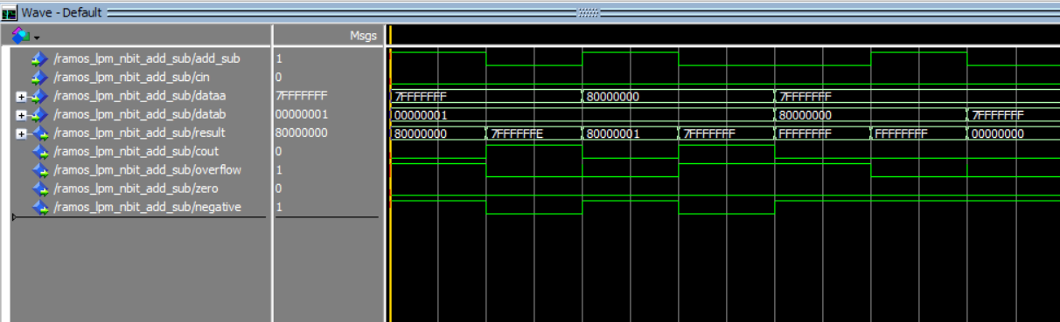
Task 9 - N-Bit Adder/Subtractor (LPM)
a b c d e f g
overflow overflow overflow
Figure 19: N-Bit Adder/Subtractor with V,Z,N flags (LPM Simulation) (N = 32)

Slide 21
Task 9 - N-Bit Adder/Subtractor (LPM)
Figure 20: Comparison of figures 15 and 18

Slide 22
Task 9 - N-Bit Adder/Subtractor (LPM)
Figure 21: Comparison of figures 16 and 19

Slide 23
Task 10: Testbench

